Slide 1
Psychology 12: A Technology Implementation Plan
http://kennedypsychology12.wordpress.com/

Slide 3
My intentions for this assignment…
Posting a reflection on Weebly site (screen shots, reflection on use of technology, pedagogy, and content)
Use the TPAC model to situate reflections, and also to guide any improvements to bring to the approach.

Slide 4
A Reflection of Practice using the TPAC Model
TPACK, with its emphasis on the interaction teachers' knowledge of Content, Pedagogy, and Technology, places teachers front and center as designers of curriculum, who flexibly and creatively integrate technology and pedagogical approaches to help their students understand subject matter.
http://www.tpack.org/

Slide 5
What is TPACK?
“Content (CK), Pedagogy (PK), and Technology (TK). The TPACK approach goes beyond seeing these three knowledge bases in isolation. TPACK also emphasizes the new kinds of knowledge that lie at the intersections between them, representing four more knowledge bases teachers applicable to teaching with technology: Pedagogical Content Knowledge (PCK), Technological Content Knowledge (TCK), Technological Pedagogical Knowledge (TPK), and the intersection of all three circles, Technological Pedagogical Content Knowledge (TPACK).”
http://www.tpack.org/

Slide 6
A Class Website
This semester, I’ve attempted to try something new with my Psychology 12 students—I created a class website, which facilitated students deeper understand of Psychology, including knowledge that this field of human behaviour is multifaceted and pervasive in the world. The website helped students see their place in the wide-world of psychology. As well, I students were given many opportunities to explore various technologies in order to represent their understanding of Psychology in a new and dynamic way.
The website allowed me to manage my classroom, that is a place store the assignments, PowerPoint's, related video, websites and blogs, and to accommodate student-created work, such as blogs, Prezi presentations, other presentation formats, as well as student Weebly Websites.
The Web 2.0 technologies help to transform student knowledge and understanding of Psychology content
The weekly blog was valuable for students to express their personal understanding and knowledge of the content, to improve their personal writing and reflections and to motivate them to access “professional” content (articles and research).

Slide 7
Reflective Blogging
Knowledge of the use of blogging in support of content-specific activities and representations constitute the technology, pedagogy and content aspects of the model.
Much of the planning process revolved around the specific learning objectives and goals of the course. From here, the knowledge of general pedagogical activities, for instance, using blogs to motivate students and to communicate, help to achieve the learning outcomes for the course.

Slide 10
The Class Blog
The students’ “voice” is regularly heard in their reflective writing on the class blog; they are free to express their ideas, learning and questions about a specific topic. The students are expected (as part of their overall mark) to participate and to respond (post constructive comments) to their peers writing. My role is to constantly monitor and reflect upon student engagement and create activities that encourage engagement of all students

Slide 11
Why Use Digital Tools?
“The use of digital tools will afford them the opportunity to deepen their skills in communication, collaboration, critical thinking, and creation. At the same time, as part of a connected global community, my students will become self-starters who can model and coach while knowing how to learn and share with transparency and respect.” (Dolores Gende)
http://plpnetwork.com/2012/12/11/evolution-teaching/

Slide 13
Rationale for Technology Integration
Technology provides for opportunities to connect with the content, to work creatively, to construct knowledge and discover new experiences. As teachers, we must be willing to allow students to explore the content and allow for creative play of ideas.

Slide 15
Technology: The Beginning Stages A Preliminary Inquiry Project
Students were learning about various States of Consciousness in class.
I posed an array of inquiry questions from which the students chose one to explore, research and ultimately answer.
They were to “answer” the question in a presentation which utilized the Pecha Kucha format (with PowerPoint).
Students also opened a Delicious account in order to cite their sources—this was shared with me.

Slide 19
Playing with Technology: A Prezi Presentation
While studying Psychological Disorders, the students created Prezi presentations which describe, identify and classify specific psychological disorders. The assignment was to be completed in pairs or individually. Again, they were to cite their sources on their personal Delicious bookmark page or choose to cite them on their assignment.
Assignment Learning Outcomes:
To identify and describe the major contributors and key factors to a psychological disorder.

Slide 26
Engaging Students
The purpose of the Inquiry Project was to engage my students by making connections to their interests in Psychology.

Slide 28
Inquiry Question
At the beginning of the inquiry-based learning project, the students decided on a topic of interest (in any area of Psychology), and begin to formulate a central question to investigate. From here, they began the process of constructing their own understanding and knowledge of the their topic.

Slide 29
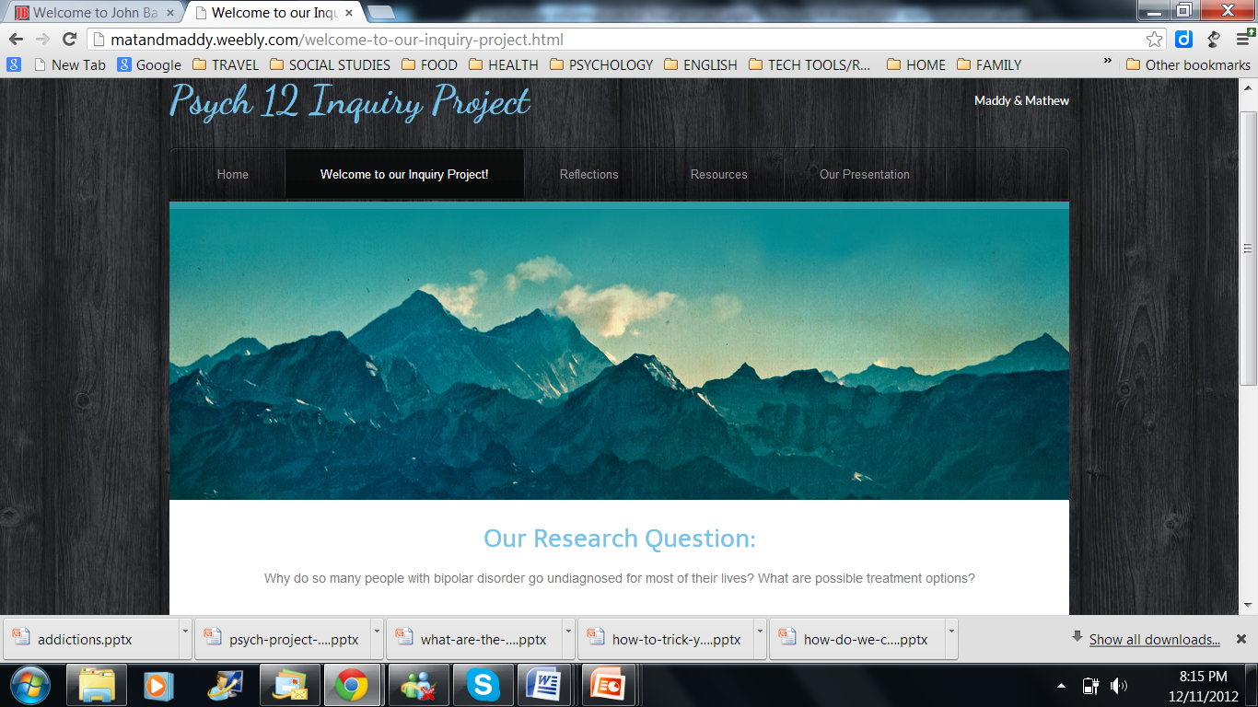

Slide 30
Technology Applications
Within the inquiry process, the students create a web space in which they reflected on their learning (at each stage) and also shared their understanding of research around their topic.
The culminating activity required students to answer their “question” in a celebration of learning presentation.

Slide 35
Reflection, Reflection, Reflection~ The Role of Metacognition
Students ability to reflect on their learning aids in building on their metacognitive skills, or being aware of their own thinking skills. Reflection allows for powerful learning opportunities, which go beyond the school or this particular learning environment in that students learn how to understand and deal with their thoughts and feelings, that is both the cognitive and affective domains of learning.

Slide 36
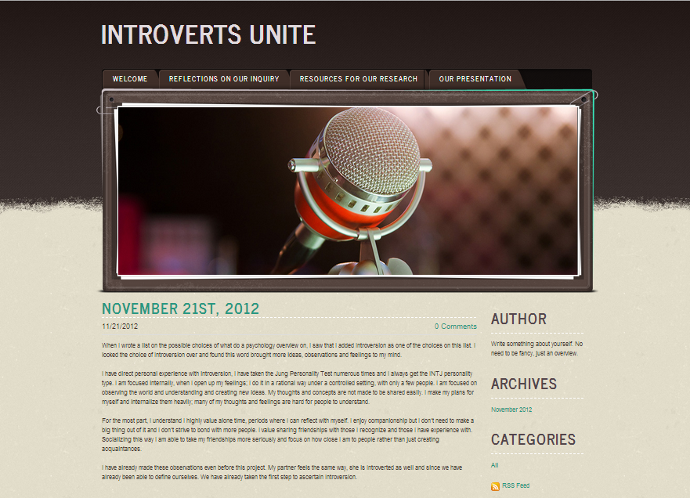

Slide 37
Student Engagement
For the past couple years I have been contemplating and re-thinking my approach to teaching. Overall, my goal is for students to have a sense of ownership and pride in their learning. As well, I am looking to create a learner-centered environment where students are actively engaged in constructing meaning and knowledge. In designing this educational platform, I was forced to think about my teaching practice, more specifically, what I wanted my students to learn (content) and how to make learning happen (pedagogy). The technological tools were chosen to emphasize the learning-goals of the course; the tools themselves do not allow for learning, but are used to support student learning. Technological applications that are dynamic allow for activities that engage students in active learning experiences.
My venture into a technology and student-centred classroom has been inspiring. I have observed notably higher student engagement and student ownership over their learning. The use of technology allowed students to build on their technological skills, work creatively and gave them opportunity to understand and represent the content in a sophisticated way.

